Slide 1
PD
n5zcs\event06.eeg
05:13:26
Seizure, sleeping (slight movement at the end of the seizure)
Bipolar montage
30 mm/sec
70uV/cm
Strips: sensitivity 300
Thalamic: sensitivity 35, High cut 500
Notes:
En una diapositiva pone: next SPES contacts 2,3 thalamus and 3,4 left thalamus, channels t6 and 02 will be the other thalamic channels not used for SPES) comprobar

Slide 2
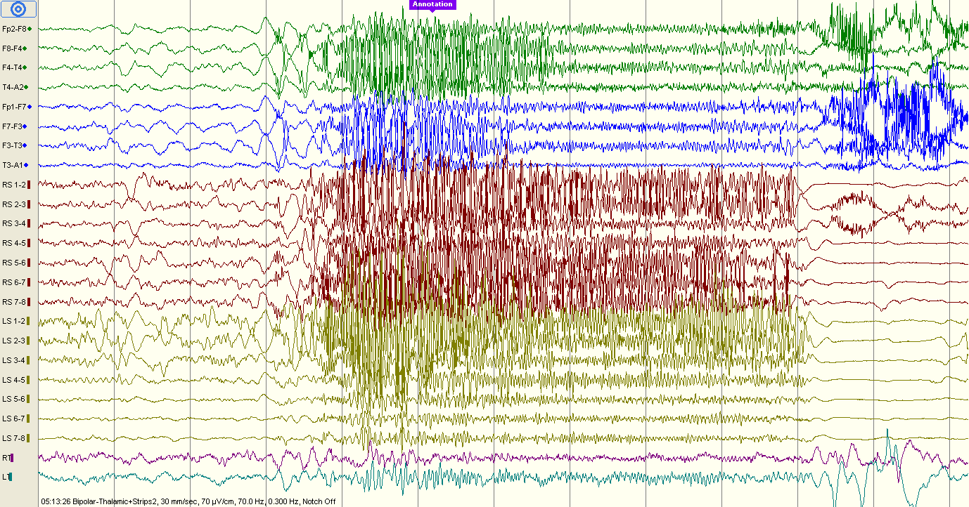

Slide 3
PD
n5zcs\event07.eeg
23:32:27
Seizure, sleeping (slight movement at the end of the seizure)
Bipolar montage
30 and 60 mm/sec
70uV/cm
Strips: sensitivity 300
Thalamic: sensitivity 35, High cut 500

Slide 4
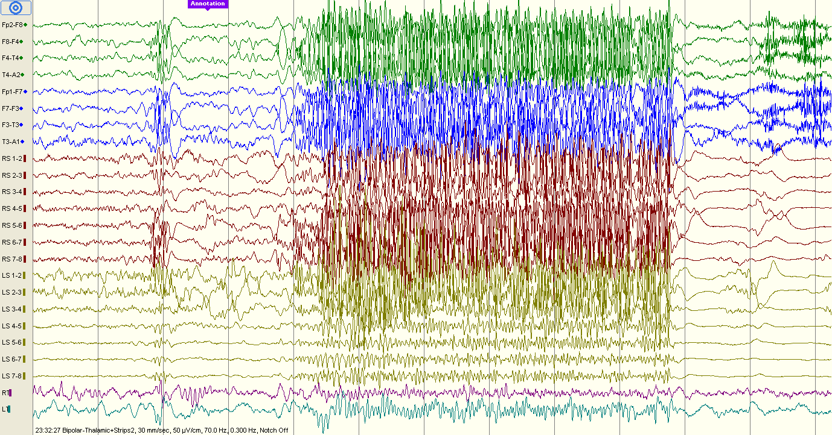

Slide 5
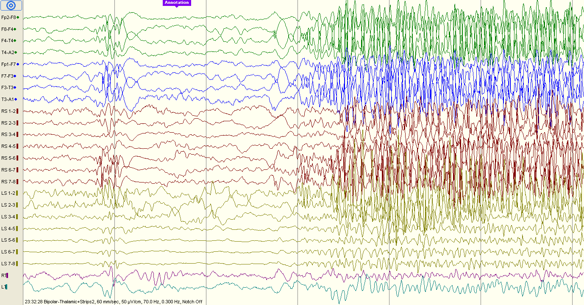

Slide 6
PD
n5zcs\event08.eeg
00:06:24
Seizure, sleeping (eyes and head movement at the end of the seizure)
Bipolar montage
30 mm/sec
70uV/cm
Strips: sensitivity 300
Thalamic: sensitivity 35, High cut 500

Slide 7
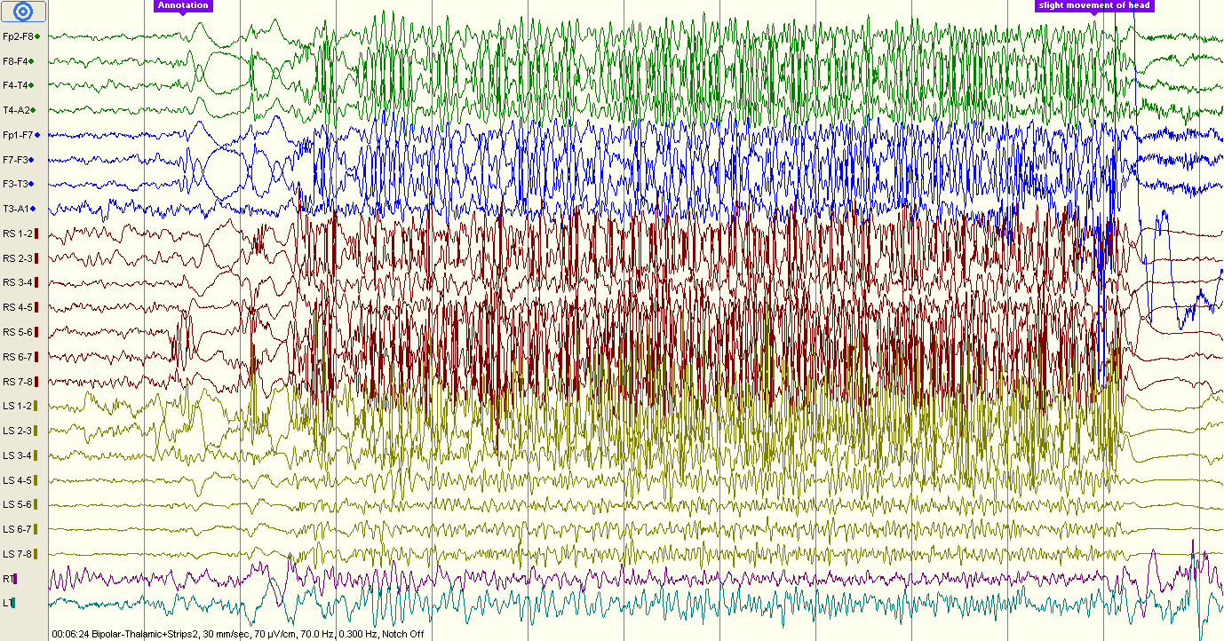

Slide 8
PD
n5zcs\event09.eeg
01:31:12
Seizure, sleeping (slight movement at the end of the seizure)
Bipolar montage
30 and 120 mm/sec
70uV/cm
Strips: sensitivity 300
Thalamic: sensitivity 35, High cut 500

Slide 9
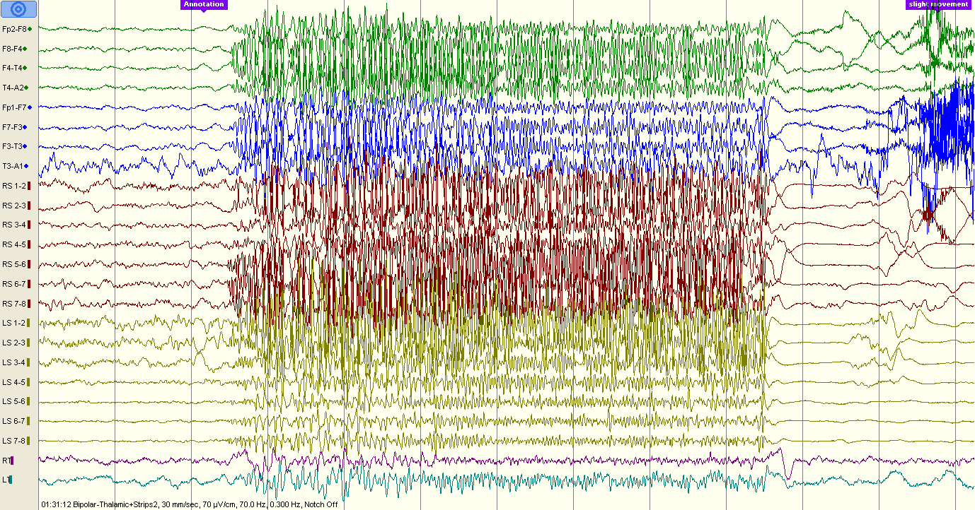

Slide 10
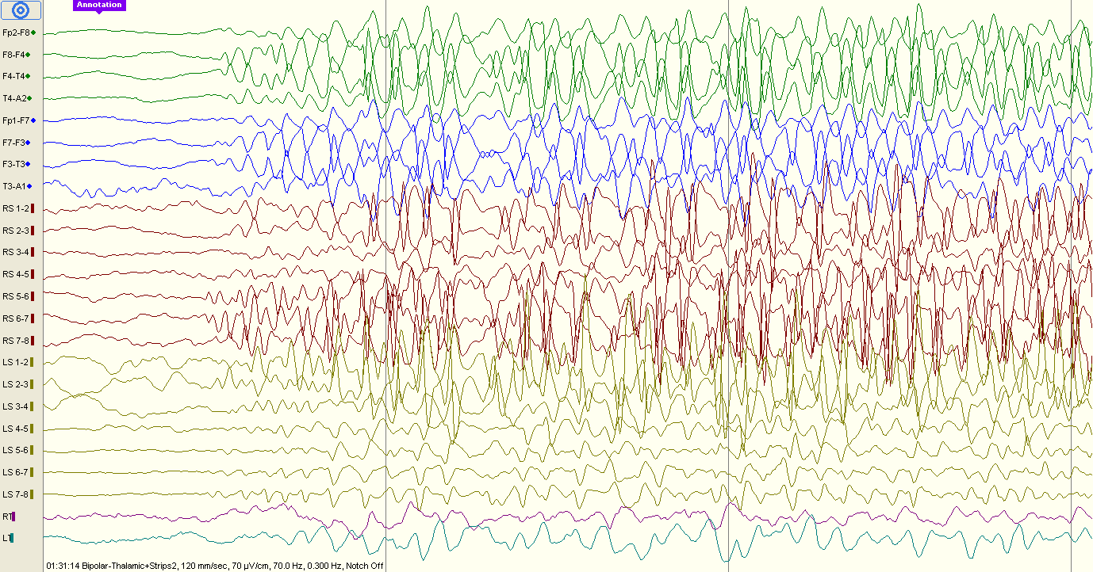

Slide 11
PD
n5zcs\event10.eeg
08:57:11
Seizure, sleeping (slight movement at the end of the seizure)
Bipolar montage
30 mm/sec
70uV/cm
Strips: sensitivity 300
Thalamic: sensitivity 35, High cut 500

Slide 12
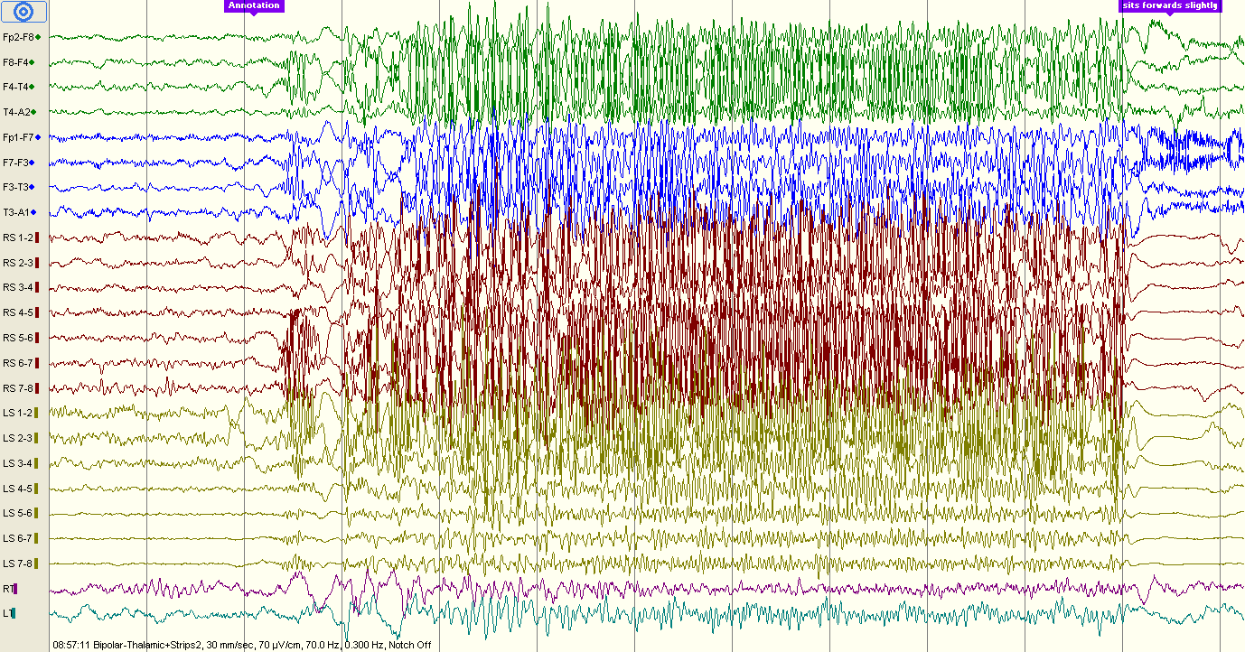

Slide 13
DP14.edf ---- 4s 75%overlap ---- 11 segments
8.57.11-8.51.53 =5min18s=318s
~318s*250Hz=79500
lasts for 10 seconds
plot(dataMat(79500:80499,:));
plot(dataMat(82000:82999,:));

Slide 14
PD
n5zcs\event12.eeg
09:13:03
Interictal activity
Bipolar montage
30 mm/sec
70uV/cm
Strips: sensitivity 300
Thalamic: sensitivity 35, High cut 500

Slide 15
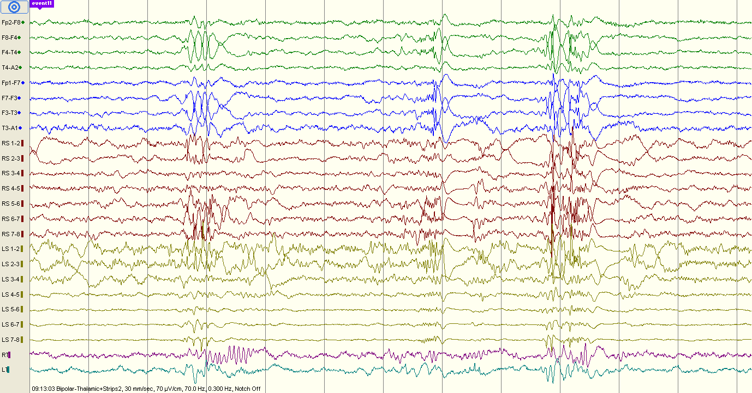

Slide 16
DP141.edf ---- 4s 75%overlap ---- 10 segments
9.13.03-9.06.57 =6min6s=366s
~366s*250Hz=91500
lasts for 9 seconds
plot(dataMat(91500:92499,:));
plot(dataMat(93750:94749,:));

Slide 17
PD
n5zcs\event12.eeg
09:13:52
Seizure, sleeping (slight movement at the end of the seizure)
Bipolar montage
30 mm/sec
70uV/cm
Strips: sensitivity 300
Thalamic: sensitivity 35, High cut 500

Slide 18
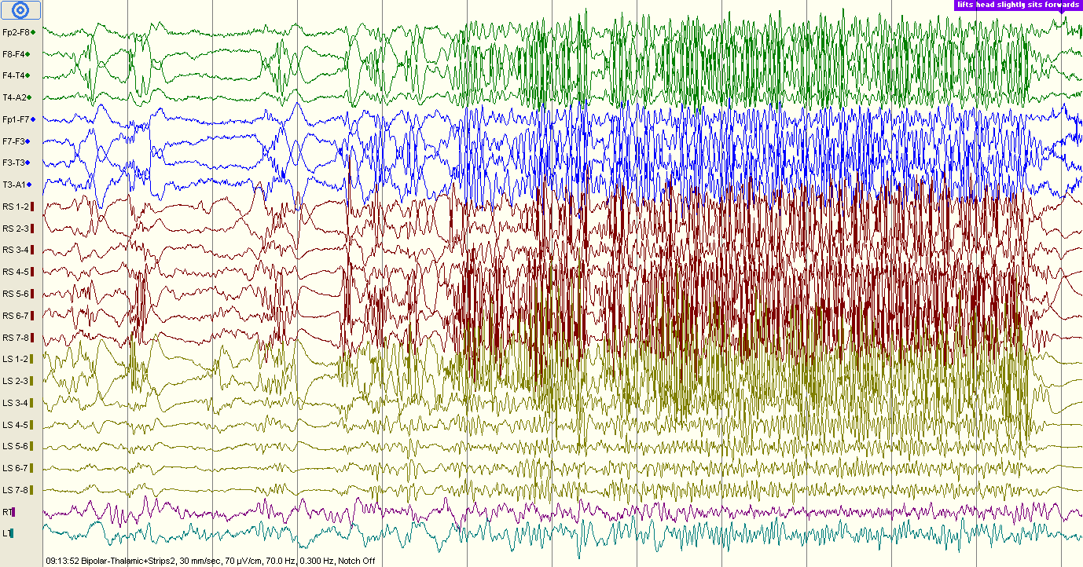

Slide 19
DP141.edf ---- 4s 75%overlap ---- 13 segments
9.13.52-9.06.57 =415s
~415s*250Hz=103750
lasts for 12 seconds
plot(dataMat(103750:104749,:));
plot(dataMat(106750:107749,:));

Slide 20
PD
n5zcs\event12.eeg
09:36:52
Seizure, sleeping (wakes up, facial grimacing vs smile, head movement)
Bipolar montage
30 and 60 mm/sec
70uV/cm
Strips: sensitivity 300
Thalamic: sensitivity 35, High cut 500

Slide 21
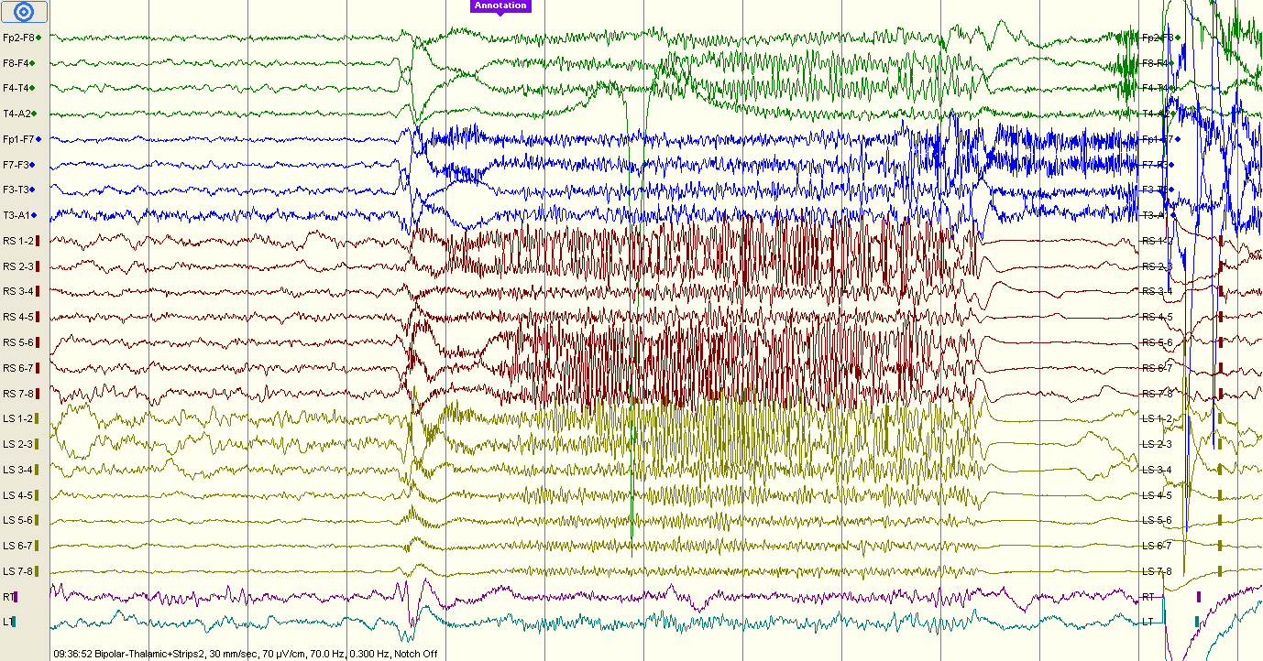

Slide 22
DP142.edf ---- 4s 75%overlap ---- 7 segments
9.36.53-9.22.01 =892s
~892s*250Hz=223000
lasts for 9 seconds
plot(dataMat(223000:223999,:));
plot(dataMat(224500:225499,:));

Slide 23
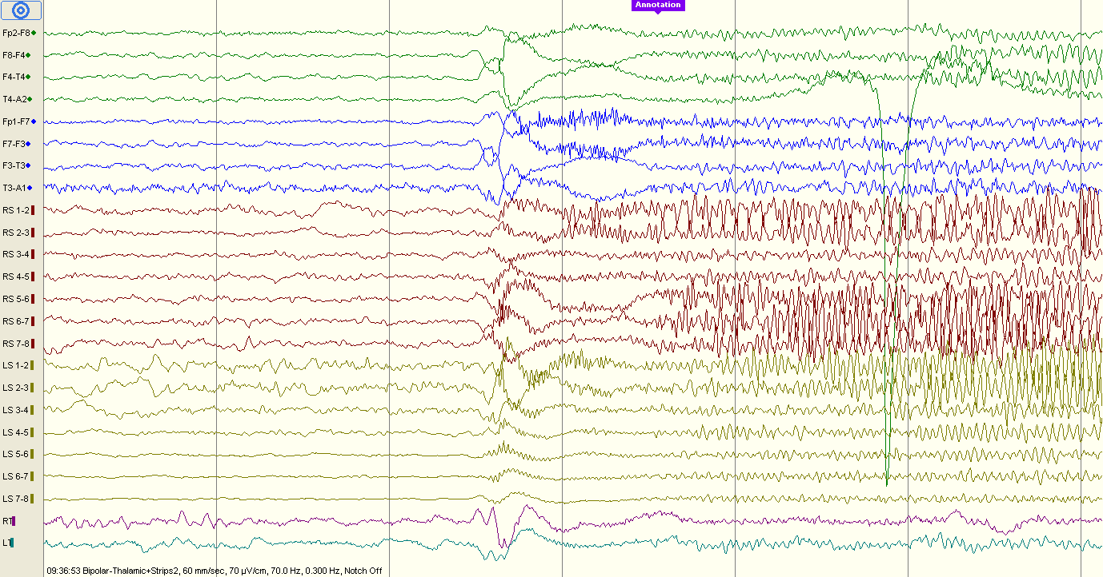

Slide 24
PD
n5zcs\event15.eeg
08:57:11
Seizure
Bipolar montage
30 and 120 mm/sec
70uV/cm
Strips: sensitivity 300
Thalamic: sensitivity 35, High cut 500

Slide 25
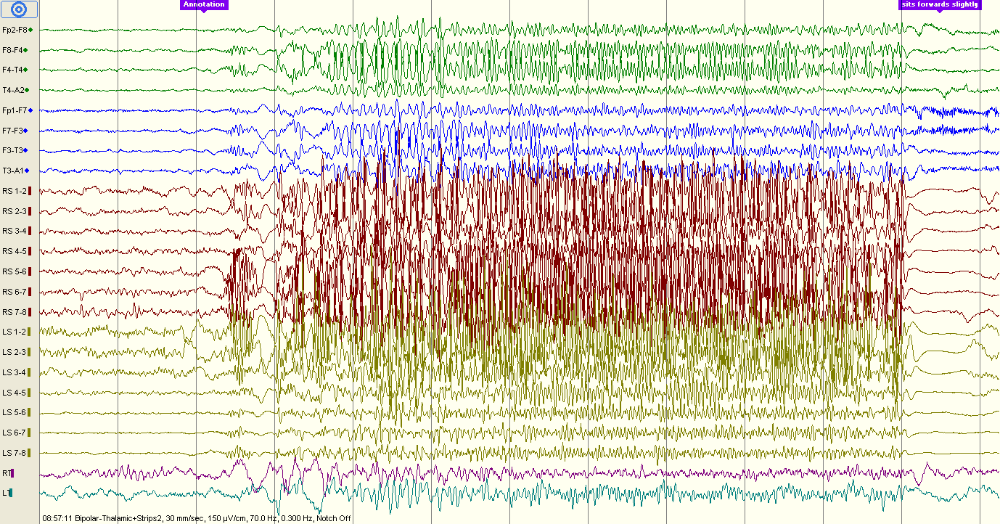

Slide 26
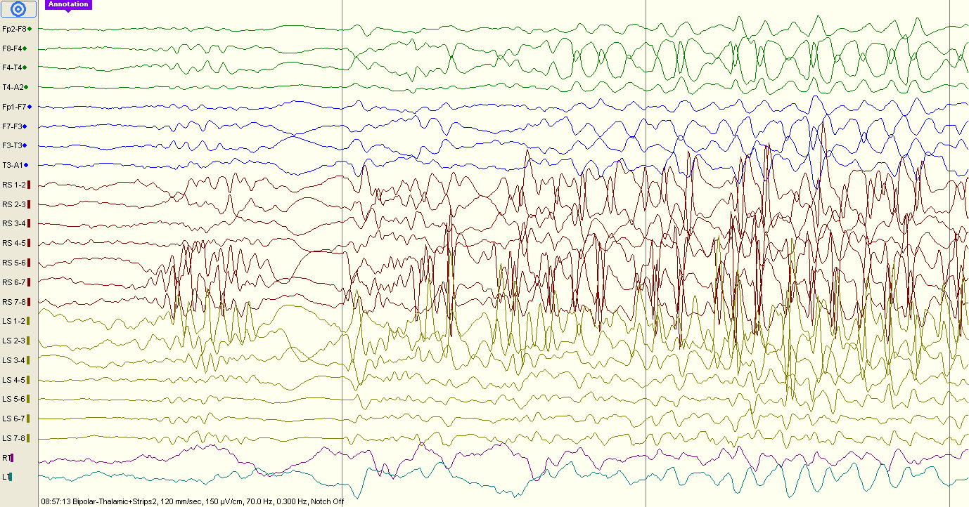

Slide 27
PD
n5zcs\event17.eeg
14:33:40
Seizure
Bipolar montage
30 mm/sec
70uV/cm
Strips: sensitivity 300
Thalamic: sensitivity 35, High cut 500

Slide 28
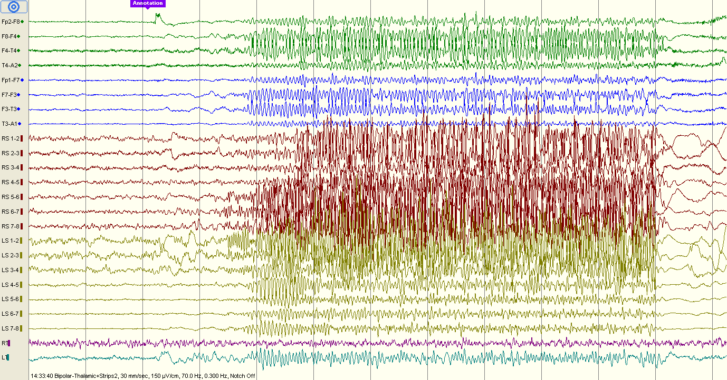

Slide 29
PD
n5zcs\event18.eeg
14:57:24
Seizure? No video
Bipolar montage
30 mm/sec
70uV/cm
Strips: sensitivity 300
Thalamic: sensitivity 35, High cut 500

Slide 30
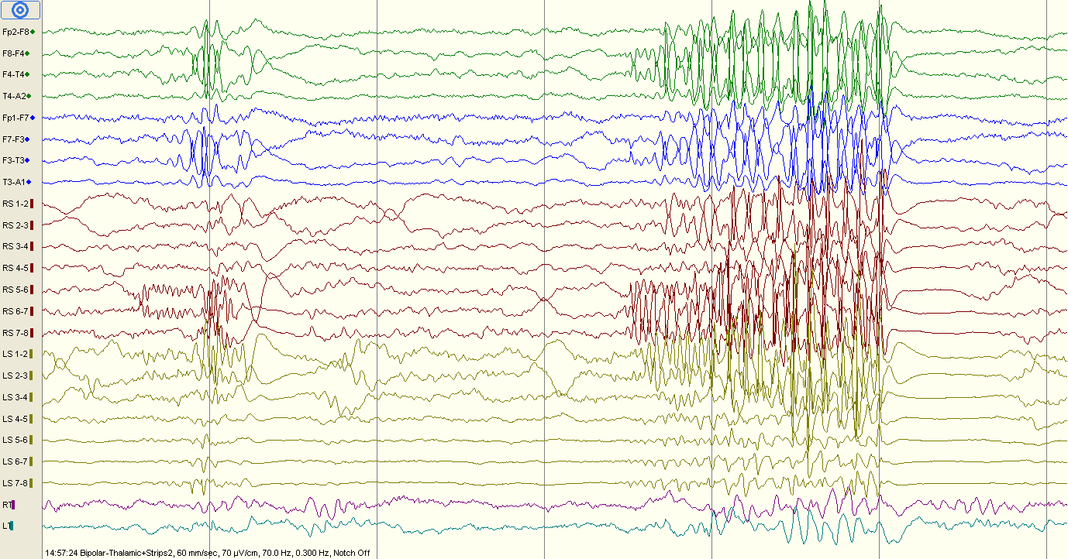

Slide 31
No corresponding data found
DP142.edf ---- 4s 75%overlap ---- 7 segments
14.57.24-14.53.02 =262s
~262s*250Hz=65500
lasts for 9 seconds
plot(dataMat(223000:223999,:));
plot(dataMat(224500:225499,:));

Slide 32
PD
n5zcs\event18.eeg
14:59:16
Seizure? No video
Bipolar montage
120 mm/sec
70uV/cm
Strips: sensitivity 300
Thalamic: sensitivity 35, High cut 500

Slide 33
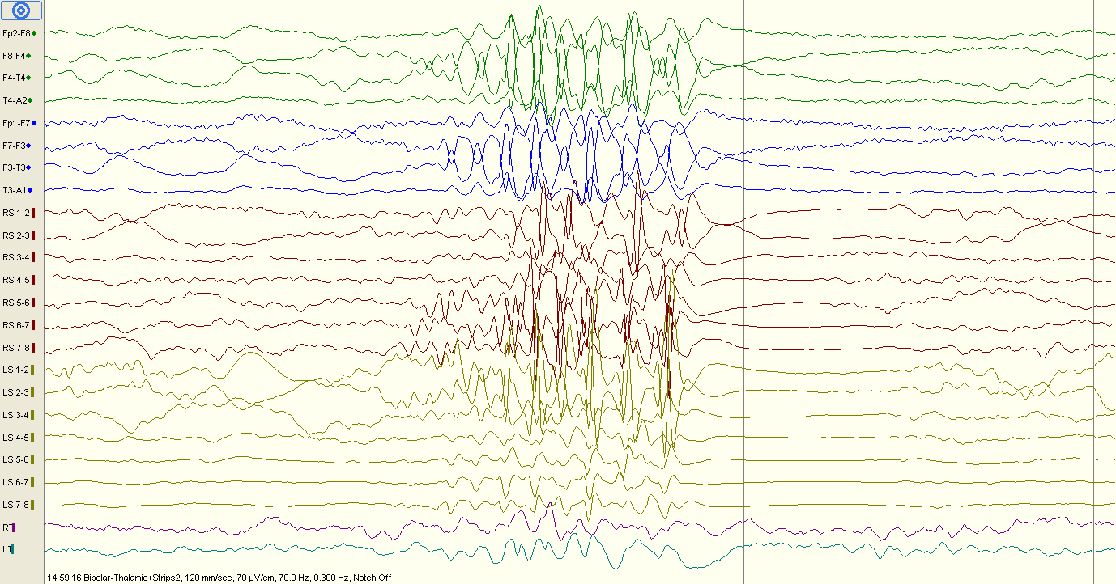

Slide 34
DP18.edf ---- 4s 75%overlap ---- 4 segments
14.59.14-14.53.02 =372s
~372s*250Hz=93000
lasts for 3 seconds
plot(dataMat(93500:94499,:));
plot(dataMat(,:));

Slide 35
PD
n5zcs\event18.eeg
15:04:42
Bipolar montage
120 mm/sec
70uV/cm
Strips: sensitivity 300
Thalamic: sensitivity 35, High cut 500

Slide 36
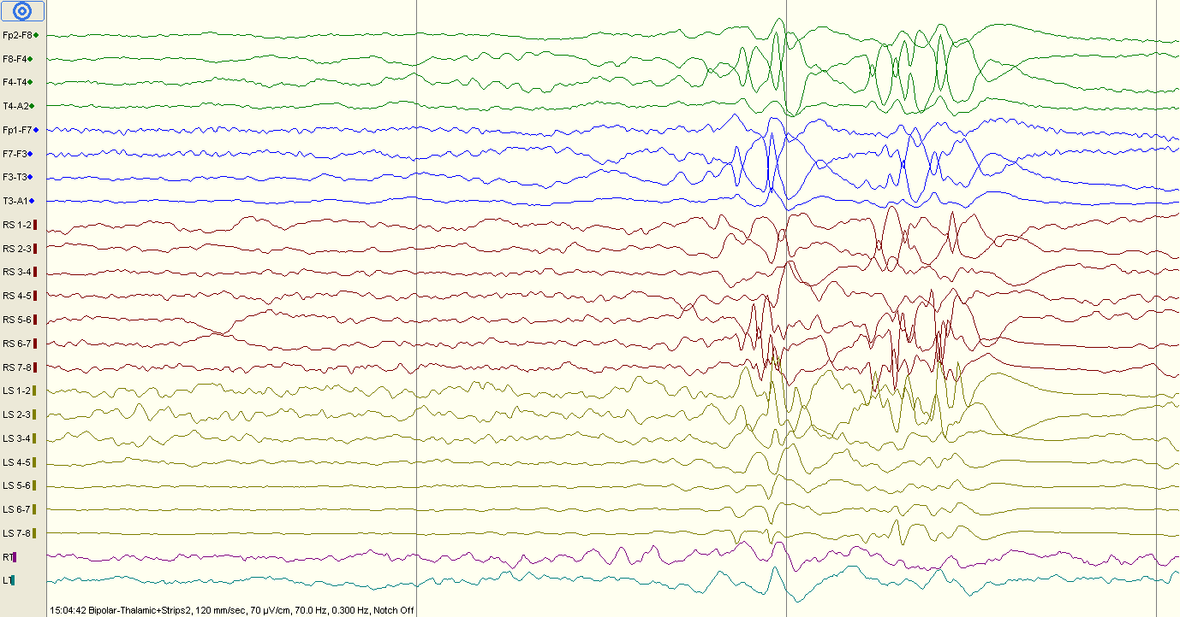

Slide 37
PD
n5zcs\event22.eeg
17:59:14
Bipolar montage
120 mm/sec
150uV/cm
Strips: sensitivity 300
Thalamic: sensitivity 35, High cut 500

Slide 38
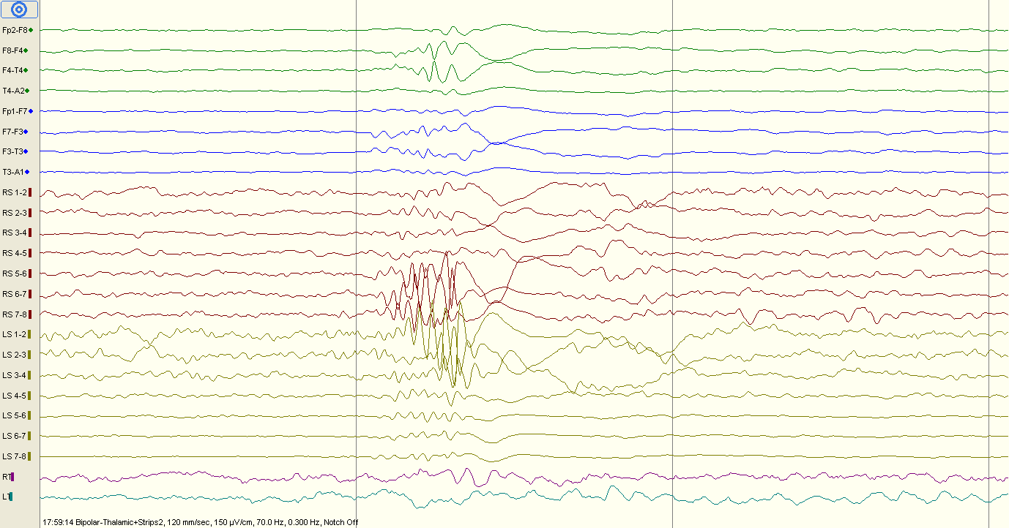

Slide 39
PD
n5zcs\event22.eeg
18:11:47
Bipolar montage
60 mm/sec
70uV/cm
Strips: sensitivity 300
Thalamic: sensitivity 35, High cut 500

Slide 40
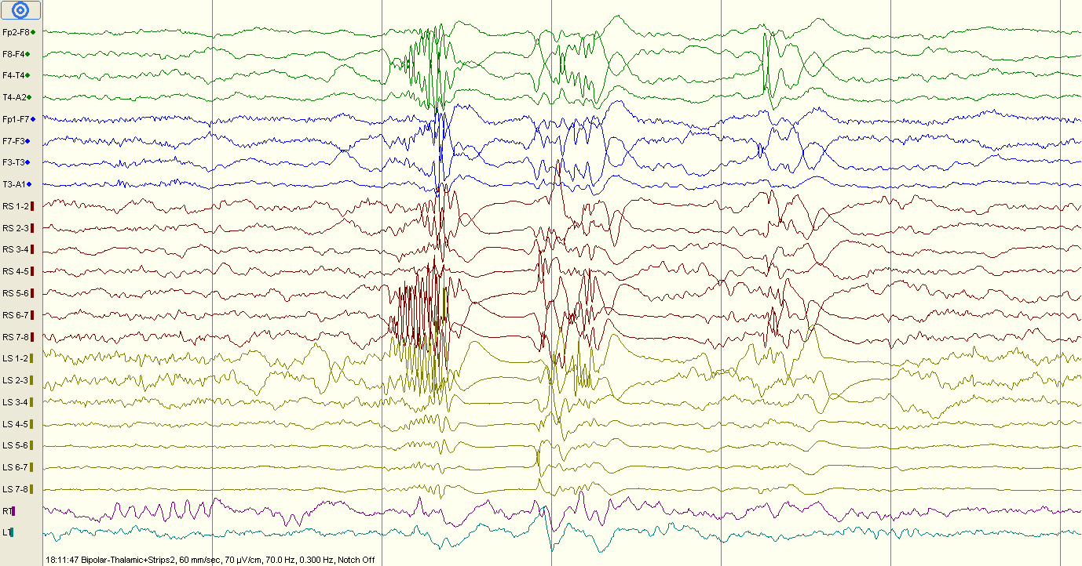

Slide 41
PD
n5zcs\event22.eeg
18:16:08
Bipolar montage
Seizure. No video
30 mm/sec
70uV/cm
Strips: sensitivity 300
Thalamic: sensitivity 35, High cut 500

Slide 42
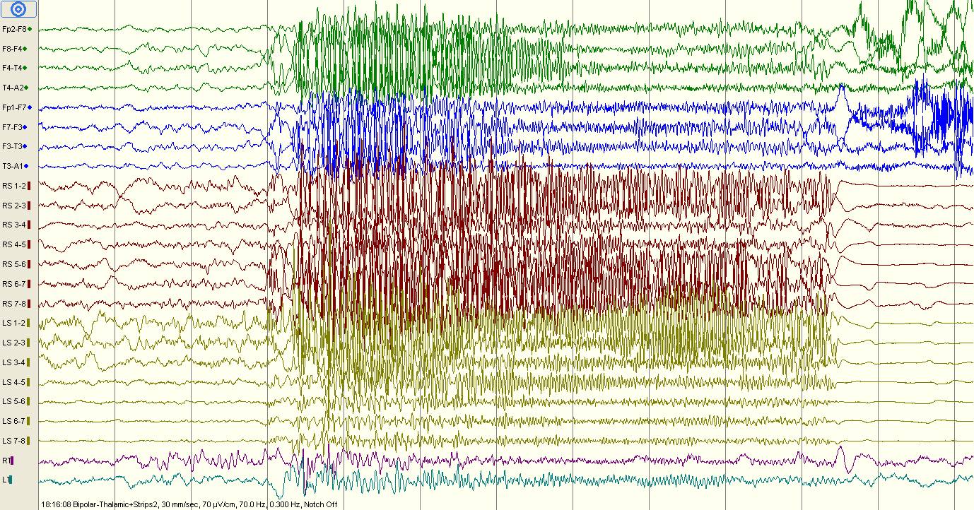

Slide 43
PD
n5zcs\event22.eeg
18:33:51
Bipolar montage
Seizure. No video
20 mm/sec
70uV/cm
Strips: sensitivity 300
Thalamic: sensitivity 35, High cut 500

Slide 44
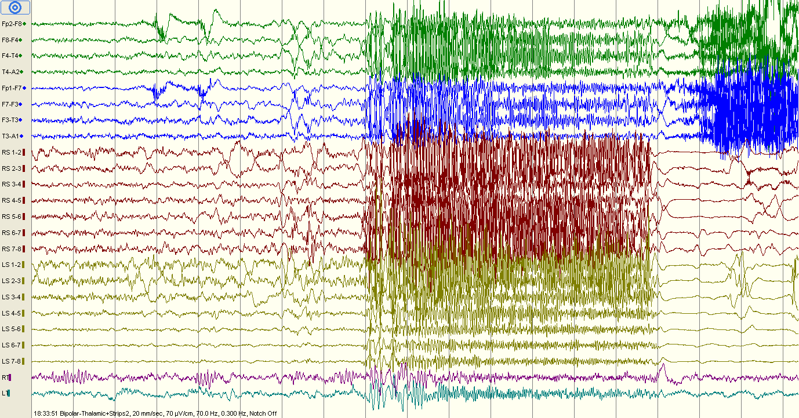

Slide 45
PD
n5zcs\event22.eeg
18:44:07
Bipolar montage
Seizure. No video
30 mm/sec
70uV/cm
Strips: sensitivity 300
Thalamic: sensitivity 35, High cut 500

Slide 46
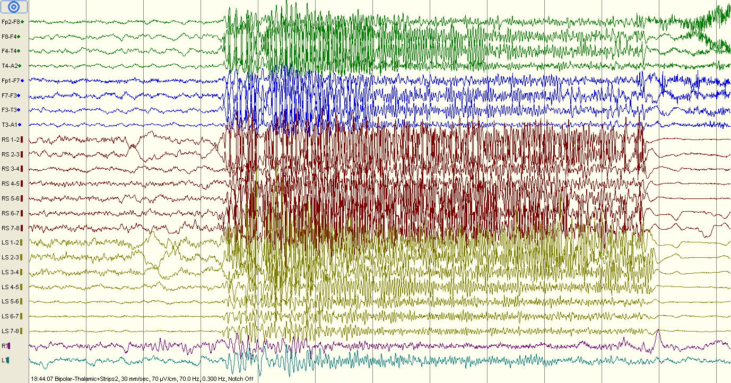

Slide 47
PD
n5zcs\event23.eeg
15:09:31
Bipolar montage
Seizure. Smile and slight head movement.
30 mm/sec
70uV/cm
Strips: sensitivity 300
Thalamic: sensitivity 35, High cut 500

Slide 48
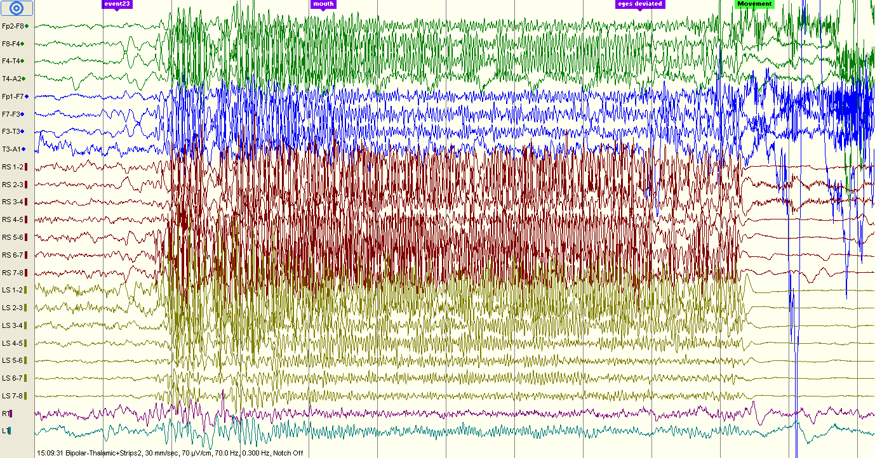

Slide 49
PD
n5zcs\event24.eeg
15:09:31
Bipolar montage
Seizure. No video (annotations: mouht, eyes deviated)
30 mm/sec
70uV/cm
Strips: sensitivity 300
Thalamic: sensitivity 35, High cut 500

Slide 51
PD
n5zcs\event25.eeg
23:24:16
Bipolar montage
Seizure. No video
30 mm/sec
70uV/cm
Strips: sensitivity 300
Thalamic: sensitivity 35, High cut 500

Slide 52
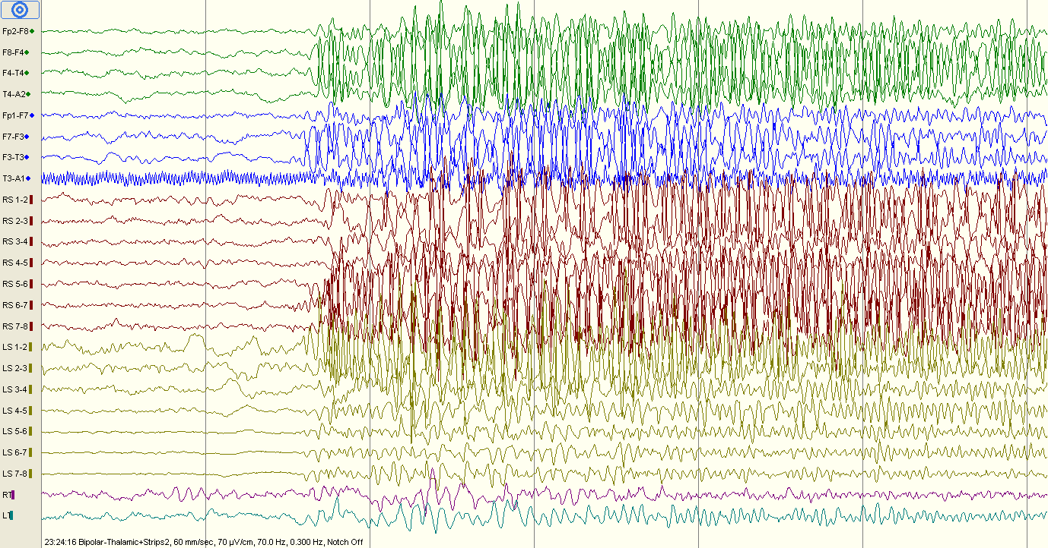

Slide 53
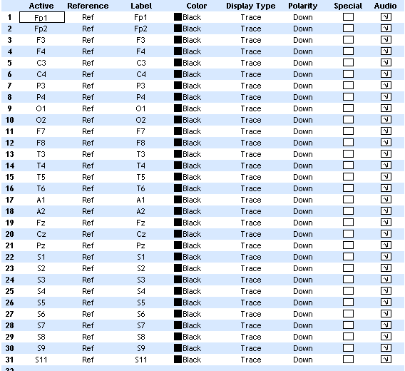
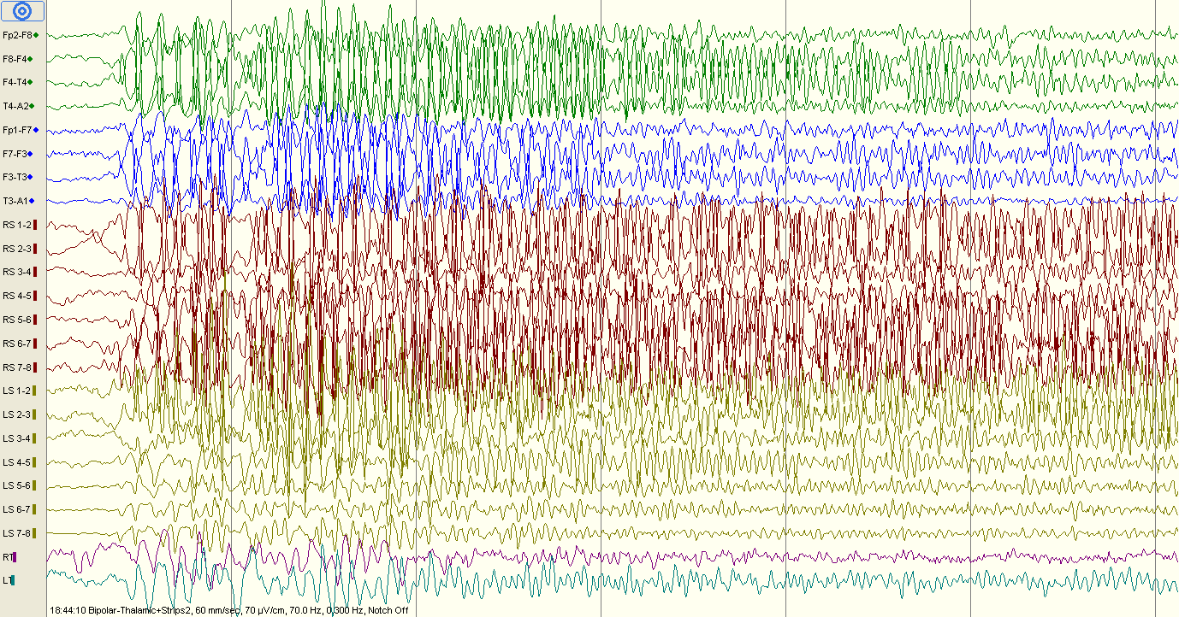
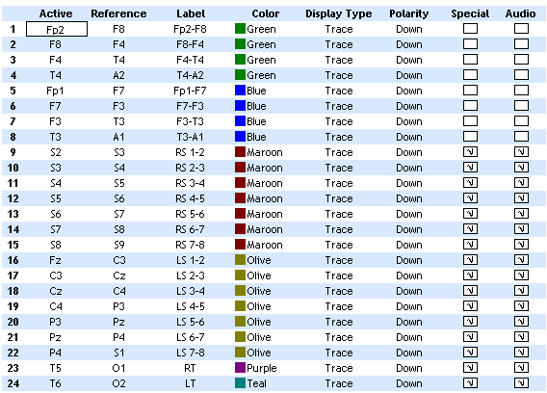
Pruned recording
Notes:
n5zcs\event22.eeg
18:16:08
Bipolar montage
Seizure. No video
30 mm/sec
70uV/cm
Strips: sensitivity 300
Thalamic: sensitivity 25, High cut 500

Slide 54
